Slide 1
CS 205
Artificial Intelligence

Slide 2
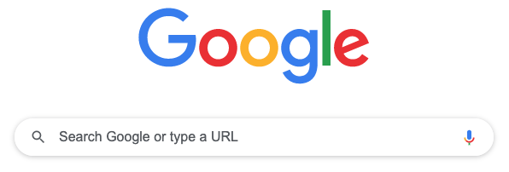
Search
Blind Search
Uniform Cost Search
Heuristic Search
Adversarial Search
Let's take a look at Prof Eamonn's slides for a minute.

Slide 3
Attendance Activity
Link will also be posted in chat so you can copy/paste.
Please listen for the secret code. It will not be repeated. Again, LISTEN.
You may NOT share or distribute or repeat the information. Only the professor can.
This is a reminder: if you are caught cheating, you fail this course immediately, a course in which you should get an A. It is NOT worth your risk.

Slide 4
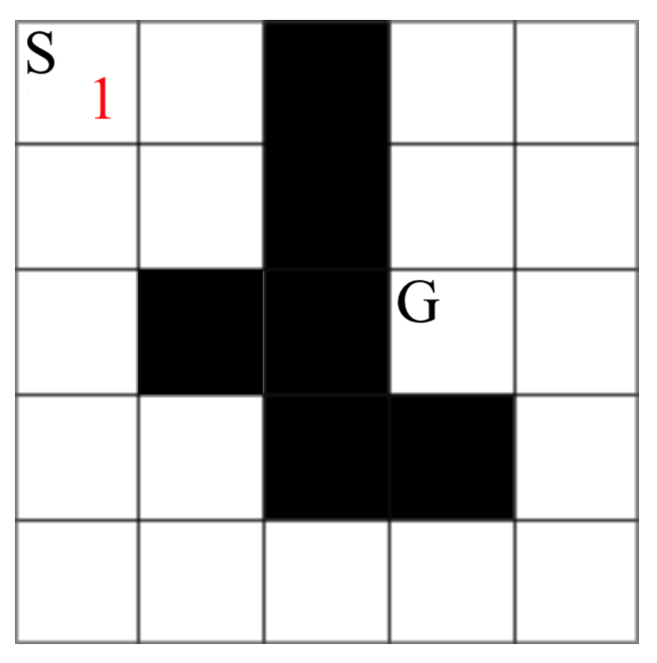
Let's play a game...
Solve this maze. The aim of this puzzle is to get from S (start) to G (goal). The operations are: U, R, D, L (up, right, down left) in that order of precedence.
For each answer we want you to write the answer two different ways: 1) label the nodes in the image in the order they are visited (1, 2, 3, 4 ...); 2) the sequence of operations taken to reach the goal along that path (U, R, R, D, L, L, ...).
solve using BFS
solve using DFS

Slide 5
Let's play a game...
S 1
Solve this maze.
Get from S to G. Operations are: U, R, D, L in that order. 1. BFS
2. DFS
G

Slide 6
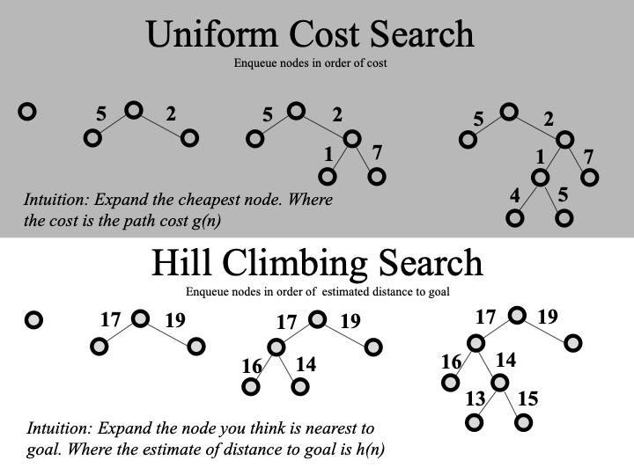
Search...

Slide 7
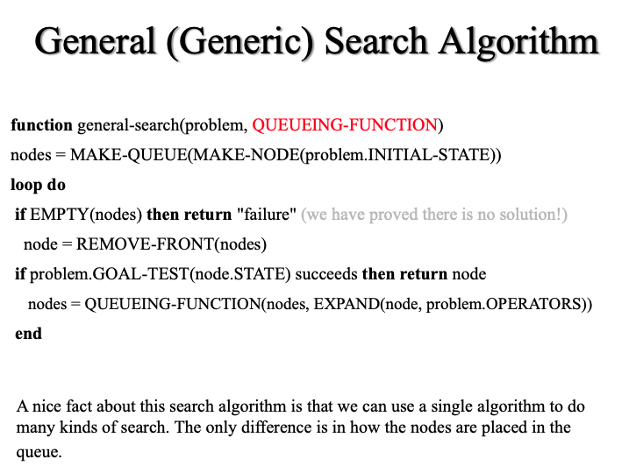
Beam Search
What is beam search?
Do not confuse with uniform cost search. Essence: fringe uses a priority queue.

Slide 8
A* heuristic search
S
g(n)
n = node g(n) = cost to reach node h(n) = remaining cost to goal, i.e., "heuristic" f(n) = g(n) + h(n) = estimated cost of next best move
Optimal! Complete! ...if heuristic is optimistic, i.e., never overestimates. Fast! ...but depends on heuristic. h(n) = 0 degenerates to uniform cost search a perfect heuristic yields straight shot to goal! Complexity: O(b^{d})
n
f(n) = g(n) + h(n)
h(n)
G

Slide 9
Heuristic
Build up an arsenal of tricks, try stuff.
Puzzles:
Euclidean or Manhattan distance
Tiles:
Number of errors (misplaced tiles)
8-Queens?
What is it?
How do I find it?
Which is the best?

Slide 10
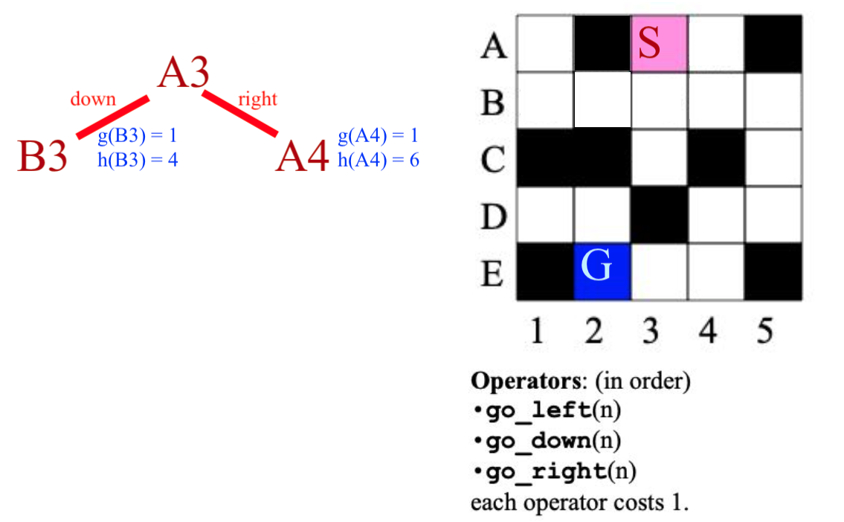
Let's play a game...
Solve this maze.
Get from A3 to E2. Operations are: L, D, R, each costs 1. 1. BFS
2. DFS
3. A*

Slide 11
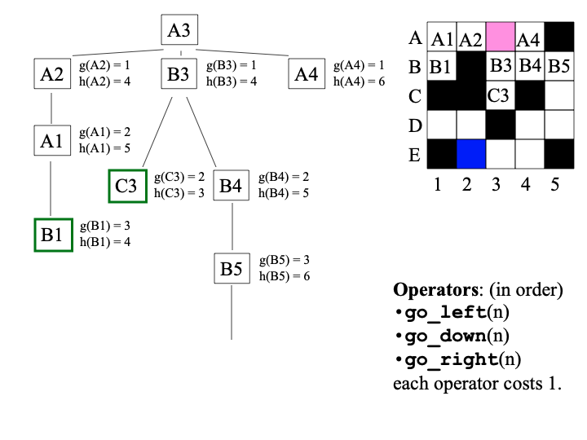
A* example
... let's do it!

Slide 12
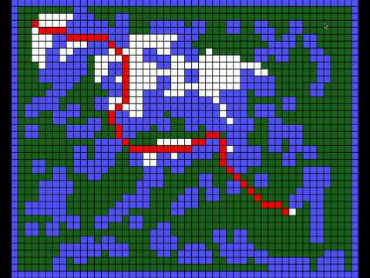
A* in action
Watch A* search in action...

Slide 13
Search
Blind Search
Uniform Cost Search
Heuristic Search
Adversarial Search
Let's take a look at Prof Eamonn's slides for a minute.

Slide 14
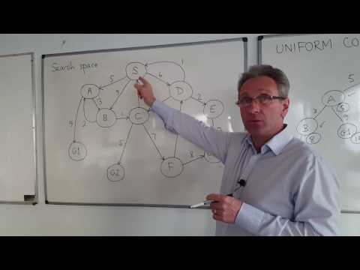
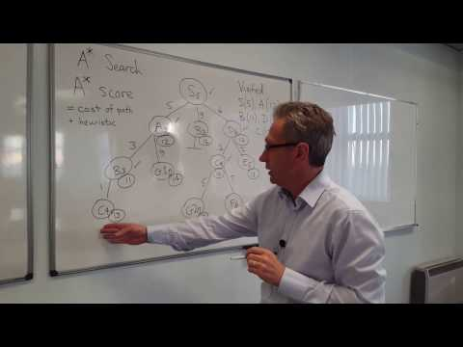
Other nice slides & resources
https://courses.cs.washington.edu/courses/cse473/12au/slides/lect3.pdf https://www.geeksforgeeks.org/a-search-algorithm/ http://www.cs.cmu.edu/afs/andrew/course/15/381-f08/www/lectures/HandoutUninformedSearch.pdf

Slide 15
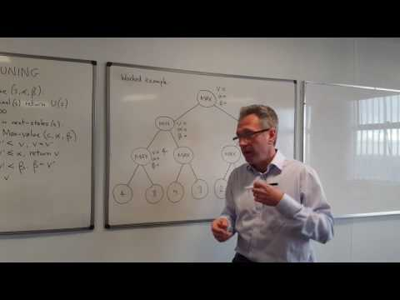
Next time: adversarial search
When you have an opponent... minimax with alpha-beta pruning.

